Slide 1

Stock Market Prediction using Machine Learning
Harshit Dhawan
Suneetha Irigireddy
Charlotte Zimmerman
Neela Julapalli

Slide 2


Money Money Money
Money is like your army sent out in the morning.
In the evening not only it should come back, it should bring back additional army too!

Slide 3
Stock Market
Volatile
changes every second, minute, hour even when you are asleep – Global market baby!
Daily big data
Thousands of financial instruments
Changing price values
Portfolio valuations, performance
investments
Multiple influences
Corporate decisions
Past performance, enterprise strategies
Sentiments
Weather – yes even weather has an influence!!
End Goal
Wise investments – Buy low, sell high.
Long term maximum profit – Retire in Hawaii
Least possible losses – Loss? What’s that.

Slide 4

System
This project attempts at creating
An engine
To analyze the market data
Provide an estimate and movement direction
Graphical Interface
A stand-alone website to show projections

Slide 5
How we did it
Price Prediction
How can I maximize profit?
Algorithms: Linear regression
Data: Historical closing price data from Yahoo Finance
Sentiment Analysis
How the economy is doing? What’s the buzz
Algorithms: Naive Bayes classifier
Data: Twitter feed content

Slide 6
Supporting Libraries & Frameworks
Numpy,
pandas, pandas_datareader.data,
Datetime
matplotlib
csv; os;
nltk.sentiment.vader; SentimentIntensityAnalyzer
Unicodedata
Sklearn: .datasets & make_regression
Pymongo
MultinomialNB
Pickle
Emoji
Textblob
Datetime
Flask
Nltk

Slide 7
System Components
1. Price Prediction
2. Sentiment Analysis

Slide 8
System Design
Data collected: Yahoo Finance
Train system with data
Save trained model (slope & intercept)
User selects stocks for portfolio
Using model, closing prices predicted

Slide 9
Data Flow
Input: Company instrument
Fetch Data
Train/Test Model
Plot Data
Predict stock for x time
Plot Predicted Results
Save Model for future use
Result displayed: Graph

Slide 10
Logical Flow
User selects a ticker instrument
Past performance data fetched from Yahoo
Model trained and tested for accuracy
Model predicts prices for future days

Slide 11
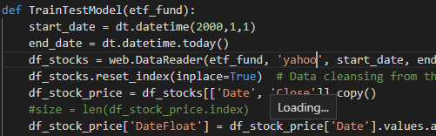
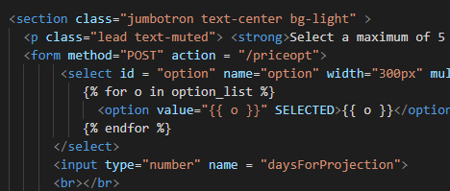
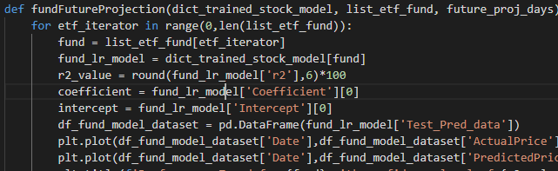
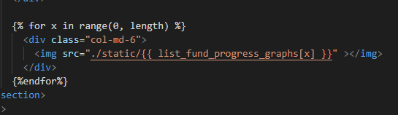
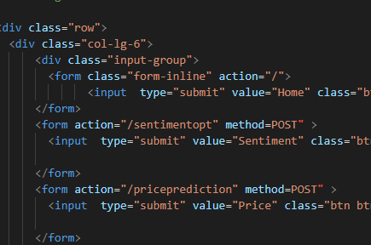
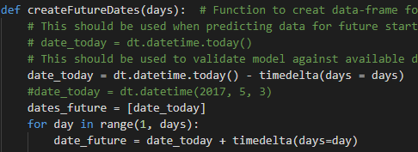
Implementation

Slide 12
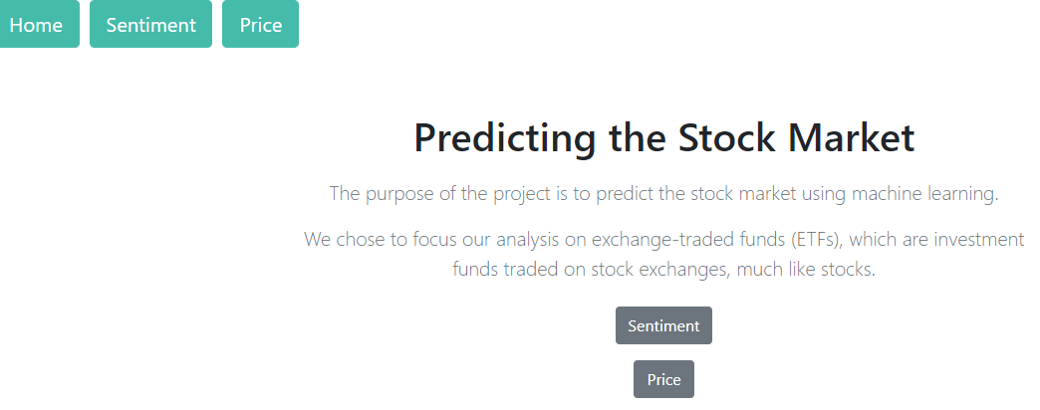
Implementation
A Select the route you want to analyze - Price

Slide 13
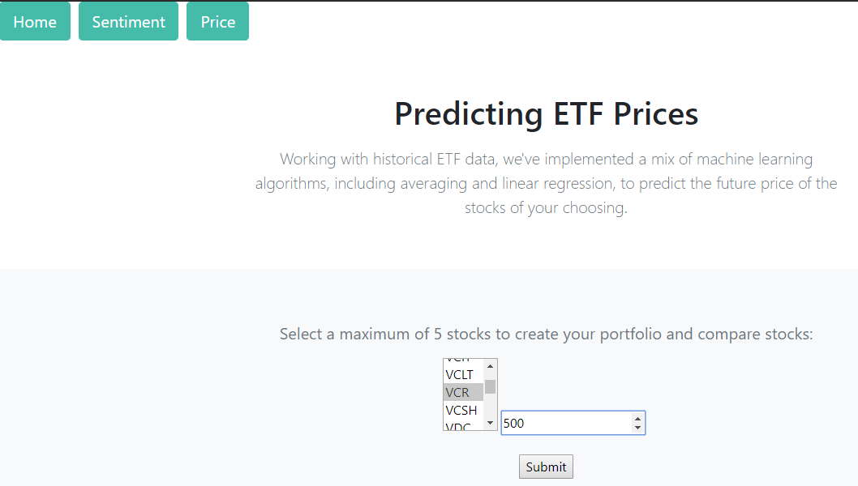
Implementation
Select your choice of fund from dropdown and provide future days for projection and click submit

Slide 14
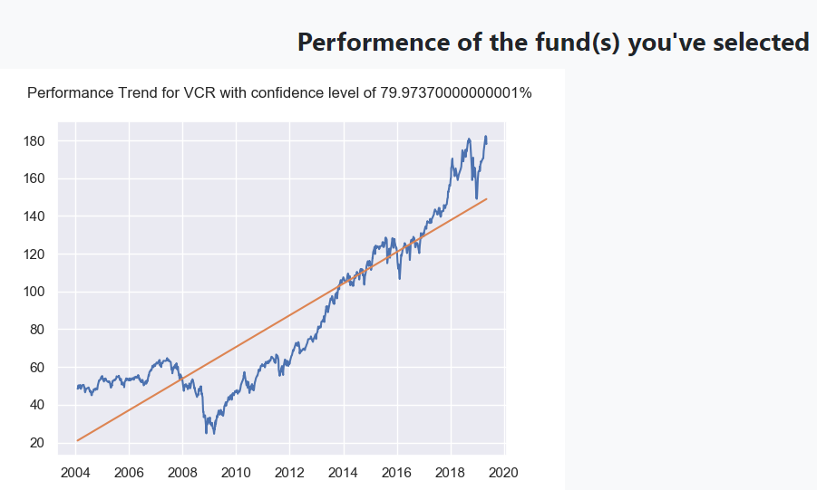
Implementation
Voila!! May the $$$ force be with you!

Slide 15
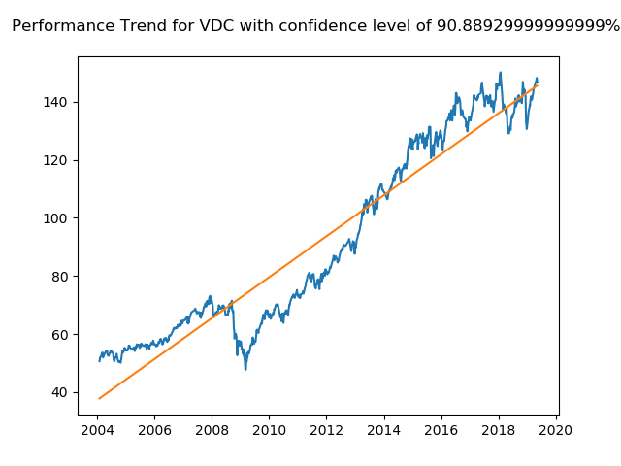
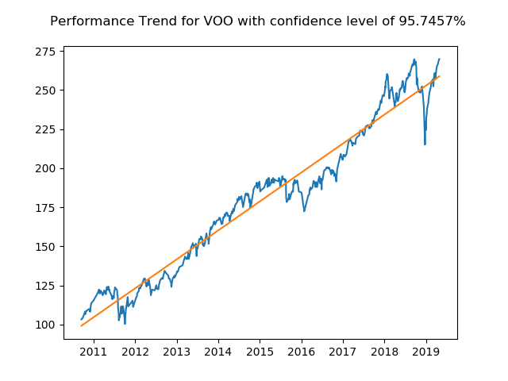
Performance

Slide 16
Performance and Constraints
Performance
Outcome have had confidence going as high as 90% + and as low as 25%
Constraints
Promising outcome for funds with minimal volatility.
Regression limited to y = mx + c
Actual y = m₀x₀ + m₁x₁ + m₂x₂ + …… + c
Next Step
This project provided with m₀x₀ now work for m₀x₀, m₀x₀ etc. and update c.

Slide 17
Modules
1. Price Prediction
2. Sentiment Analysis

Slide 18
System Design
Data collected: Twitter
Train system with data
Save trained model
User selects investor Twitter feed
Using model, classify sentiment

Slide 19
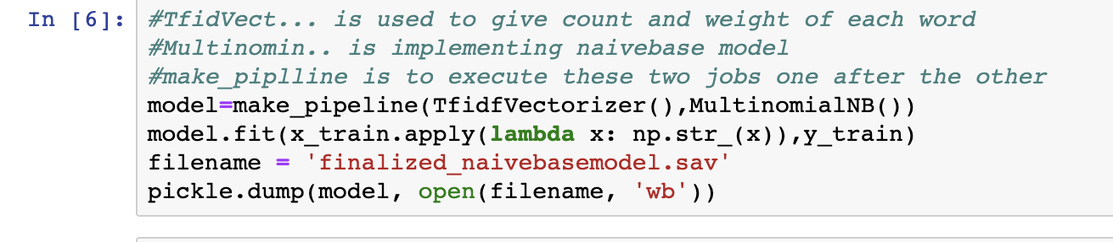
Implementation

Slide 20
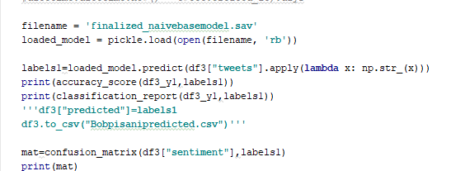
Implementation

Slide 21
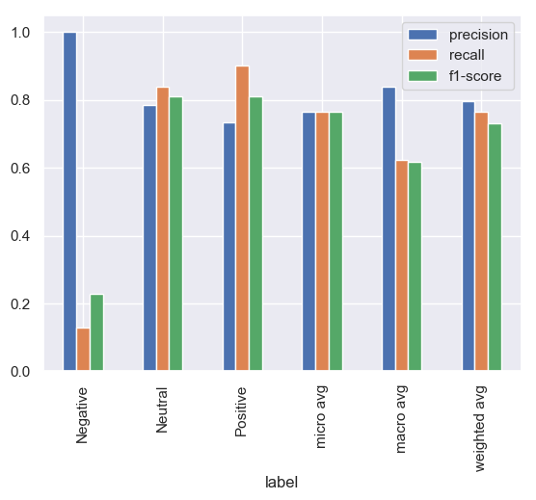
Analysis

Slide 22
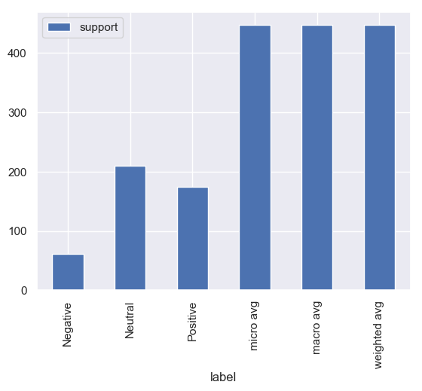
Analysis

Slide 23
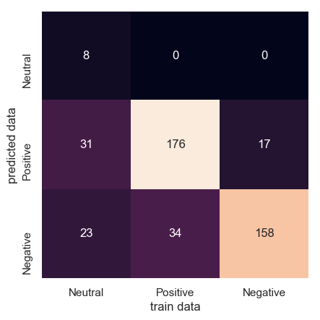
Analysis

Slide 24
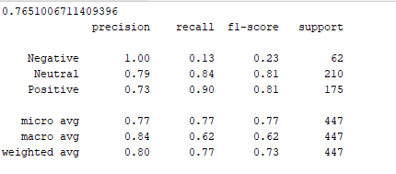
Performance

Slide 25
Challenges
Knowledge Curve
Understanding market calculus is no child’s play. A tutorial of 30 min is 1 week’s play.
Data
Data available is paid
Historical data only for 1 month
API data pull rate limited to 100 records/day
Data source down – Mayday! Mayday! Mayday!
Libraries & IDE
Quantopian: New territory – Every step a learning experience with burnt hands
Community based IDE – limited tutorials

